Slide 1


Emmanuel Ani
3/13/223

Slide 2

Outline
Executive Summary
Introduction
Methodology
Results
Conclusion
Appendix

Slide 3
Executive Summary
Summary of methodologies
Data Collection through API
Data Collection with Web Scraping
Data Wrangling (Manipulation)
Exploratory Data Analysis with SQL
Exploratory Data Analysis with Data Visualization
Interactive Visual Analytics with Folium
Machine Learning Prediction
Summary of all results
Exploratory Data Analysis result
Screenshots of interactive analytics
Predictive Analytics result

Slide 4
Introduction
This project is focused on the commercial space transport service, SpaceX, who have relatively succeeded in the space program due to their relatively inexpensive rocket launches. The aim of the project is to use the SpaceX datasets to determine the cost of a launch by predicting if the first stage of the rocket would land. The data sets were collected via an API. I used SQL and Python primarily for the whole project. Data Wrangling and EDA and visualization were done to understand some of the variables in the dataset. Folium was used in plotting the sites of the launches and other relative information. Finally, a Machine Learning model was created to predict the success of failure of each rocker launches using different classification algorithms.
The results gotten would be presented in details in the subsequent slides for your perusal.

Slide 5

Section 1

Slide 6
Methodology
Executive Summary
Data collection methodology:
Data was collected by web scraping and via spacex API
Perform data wrangling
Data was processed using pandas
Perform exploratory data analysis (EDA) using visualization and SQL
Perform interactive visual analytics using Folium and Plotly Dash
Perform predictive analysis using classification models
How to build, tune, evaluate classification models

Slide 7
Data Collection
Describe how data sets were collected.
You need to present your data collection process use key phrases and flowcharts

Slide 8
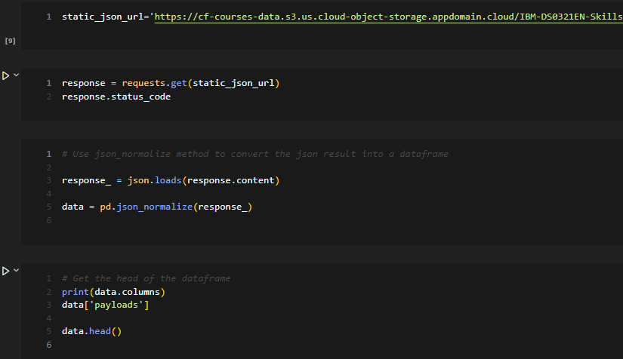
Data Collection – SpaceX API
github: https://github.com/emmanuelani/ibm_ds_capstone/blob/master/jupyter-labs-spacex-data-collection-api.ipynb

Slide 9
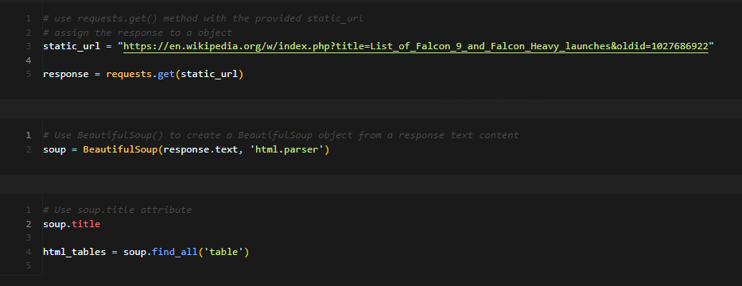
Data Collection - Scraping
Github url: https://github.com/emmanuelani/ibm_ds_capstone/blob/master/Webscraping.ipynb

Slide 10
Data Wrangling

Slide 11
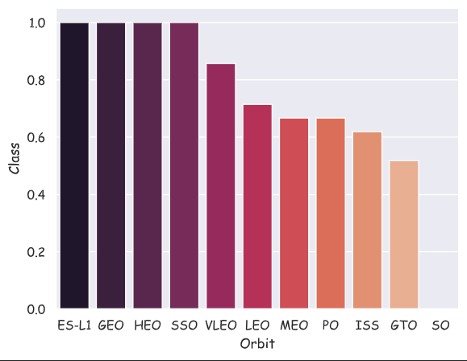
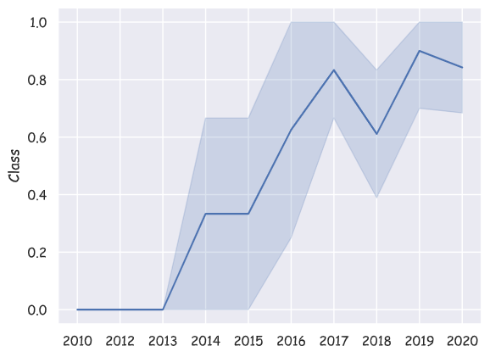
EDA with Data Visualization
Bar charts and Line charts were plotted. The bar chart was used to visualize the success rate for each orbit while the line chart was used to show the trend of success rates over the years.
Github: https://github.com/emmanuelani/ibm_ds_capstone/blob/master/jupyter-labs-eda-dataviz.ipynb

Slide 12
EDA with SQL
Using bullet point format, summarize the SQL queries you performed
Add the GitHub URL of your completed EDA with SQL notebook, as an external reference and peer-review purpose

Slide 13
Build an Interactive Map with Folium
Summarize what map objects such as markers, circles, lines, etc. you created and added to a folium map
Explain why you added those objects
Add the GitHub URL of your completed interactive map with Folium map, as an external reference and peer-review purpose

Slide 14
Build a Dashboard with Plotly Dash
Summarize what plots/graphs and interactions you have added to a dashboard
Explain why you added those plots and interactions
Add the GitHub URL of your completed Plotly Dash lab, as an external reference and peer-review purpose

Slide 15
Predictive Analysis (Classification)
Summarize how you built, evaluated, improved, and found the best performing classification model
You need present your model development process using key phrases and flowchart
Add the GitHub URL of your completed predictive analysis lab, as an external reference and peer-review purpose

Slide 16
Results
Exploratory data analysis results
Interactive analytics demo in screenshots
Predictive analysis results

Slide 17

Section 2

Slide 18
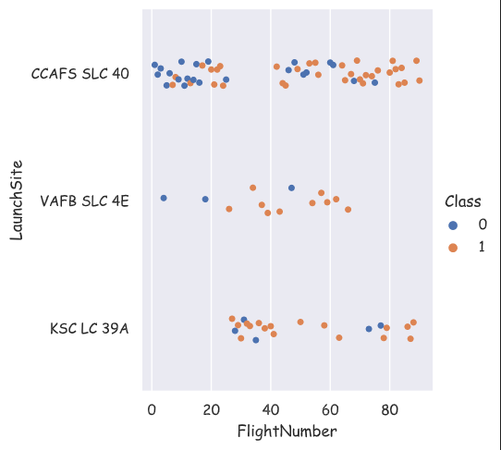
Flight Number vs. Launch Site
We can see clearly from the chart the number of flights that succeeded and failed in each launch site. KSC LC 39A and VAFB SLC 4E clearly had lesser number of flights and a higher success rate than CCAFS SLC 40.

Slide 19
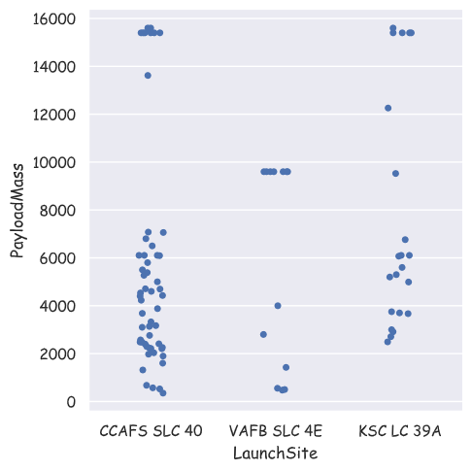
Payload vs. Launch Site
We can see clearly from the chart the launch sites and their distribution of payload masses for each launch. CCAFS SLC 40 and KSC LC 39A both had flights with payload mass above 15000kg

Slide 20
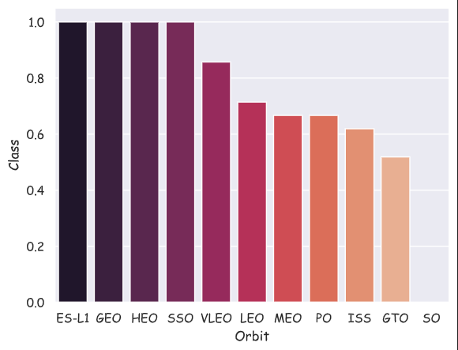
Success Rate vs. Orbit Type
This chart shows the success rate for each orbit. Orbits ES-L1, GEO, HEO, and SSO has the highest success rates among all orbits.

Slide 21
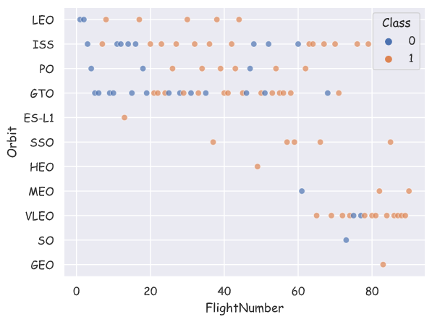
Flight Number vs. Orbit Type
The chart here shows the success rate for each orbit. You would notice that the more the number of flights for each orbit the lesser the success rate.

Slide 22
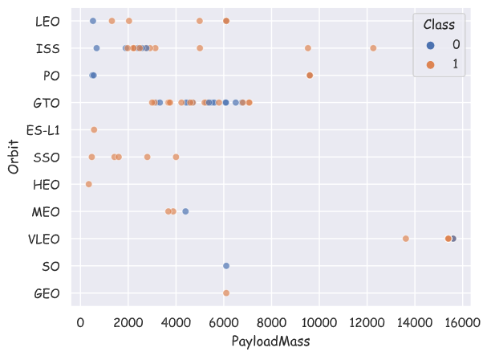
Payload vs. Orbit Type
This chart shows the payload mass for each orbit type.

Slide 23

Launch Success Yearly Trend
This chart shows the trend of the success and the failure rates for each year. We can see a markedly increase of the success rate from 2015 and a sharp drop between 2017 and 2018.

Slide 24
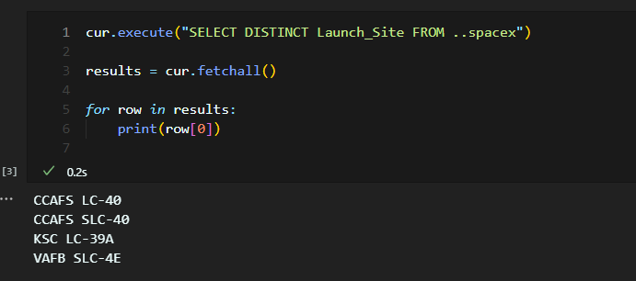
All Launch Site Names
The query shows the different sites names. The distinct sites names were gotten by using the ‘DISTINCT’ keyword to show the unique launch sites.

Slide 25
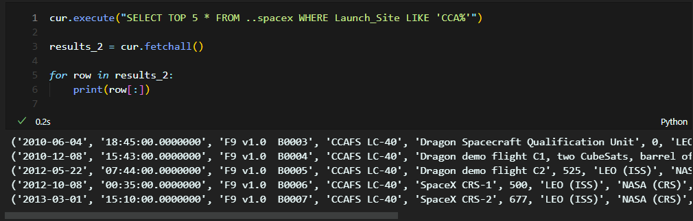
Launch Site Names Begin with 'CCA'
Here, you can see the top 5 records of the launch sites that starts with ‘CCA’. I used the ‘TOP’, ‘WHERE’, and ‘LIKE’ keywords to get this information.

Slide 26
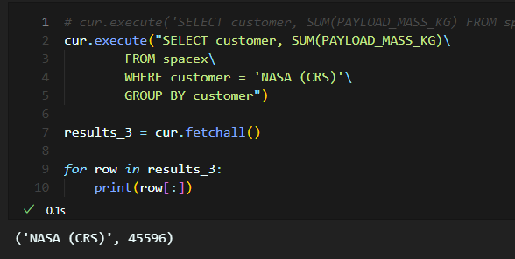
Total Payload Mass
This screenshot shows the total payload mass carried by boosters launched by NASA (CRS). The total payload mass is 45,596kg.

Slide 27
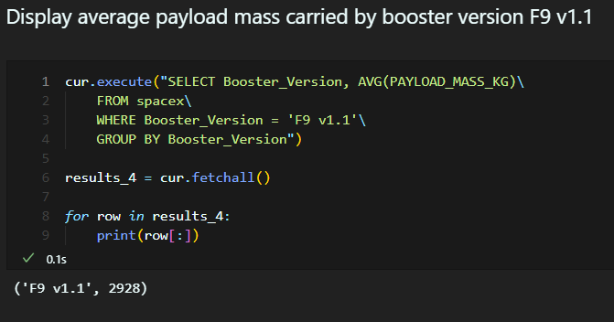
Average Payload Mass by F9 v1.1
This shows the average payload mass by F9 v1.1 booster which is 2928.

Slide 28
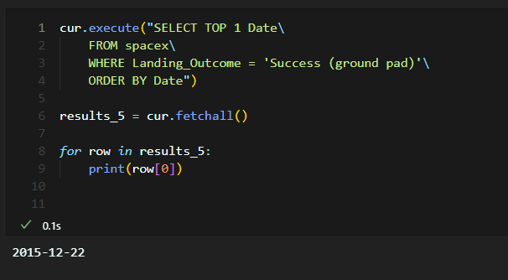
First Successful Ground Landing Date
This shows the data for the first successful landing on the ground pad. The date is shown to be 2015-12-22

Slide 29
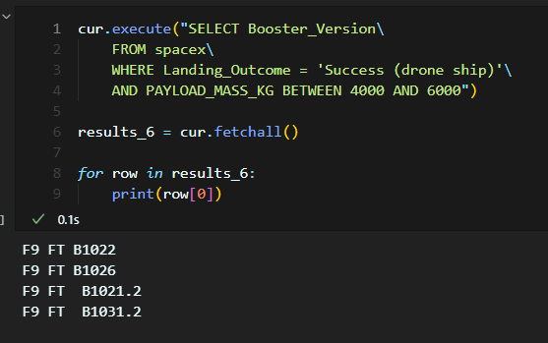
Successful Drone Ship Landing with Payload between 4000 and 6000
This shows the boosters which have successfully landed on a drone ship with a payload mass between 4000 and 6000.

Slide 30
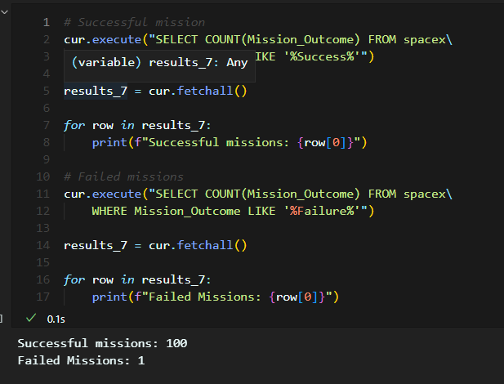
Total Number of Successful and Failure Mission Outcomes
This shows the number of successful and failed mission outcomes. Here, we have 100 successful missions and just 1 failed missions.

Slide 31
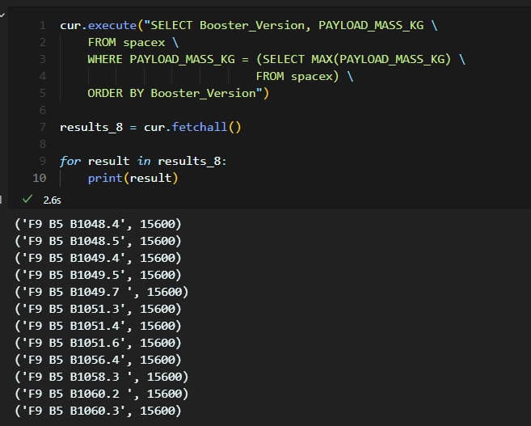
Boosters Carried Maximum Payload
This shows the boosters that carried the maximum payload. We have 12 of them listed.

Slide 32
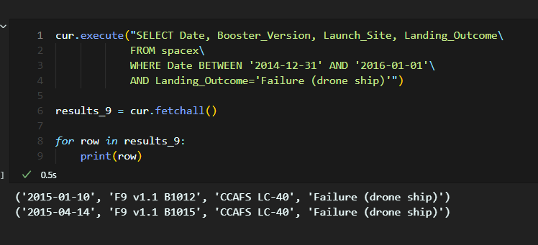
2015 Launch Records
This shows the launch records for 2015. Here, we have just 2 records from 2015.

Slide 33
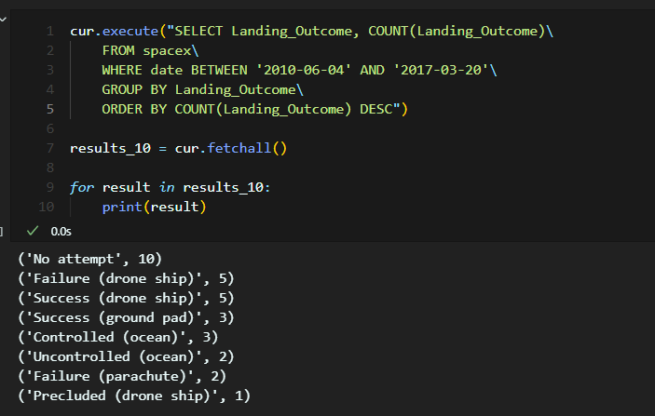
Rank Landing Outcomes Between 2010-06-04 and 2017-03-20
This shows the count of successful landing outcomes between 04-06-2010 and 20-03-2017.

Slide 34

Section 3

Slide 35
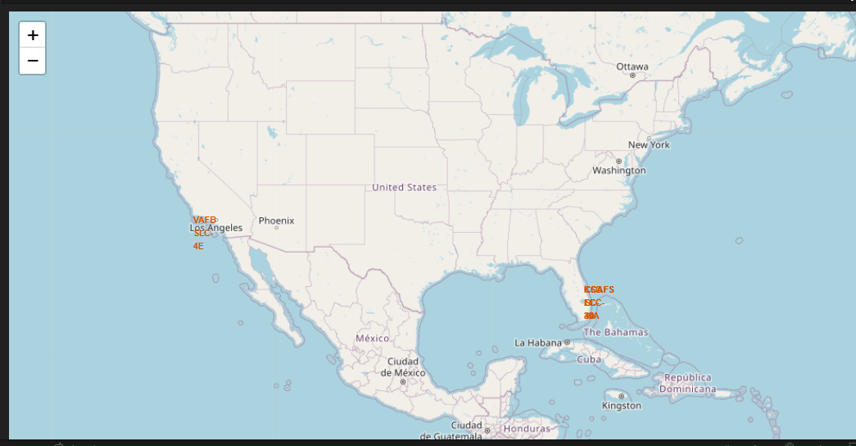
Launch Sites

Slide 36
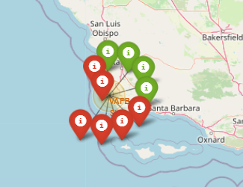
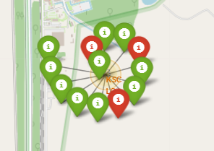
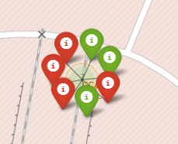
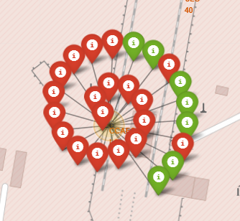
Successful and Failed Launches at different launch sites
The following screenshots shows the different launch sites with successful launches in green and failed launches in red.
KSC LC 39A
VAFB SLC 4E
CCAFS SLC40
CCAFS LC 40

Slide 37
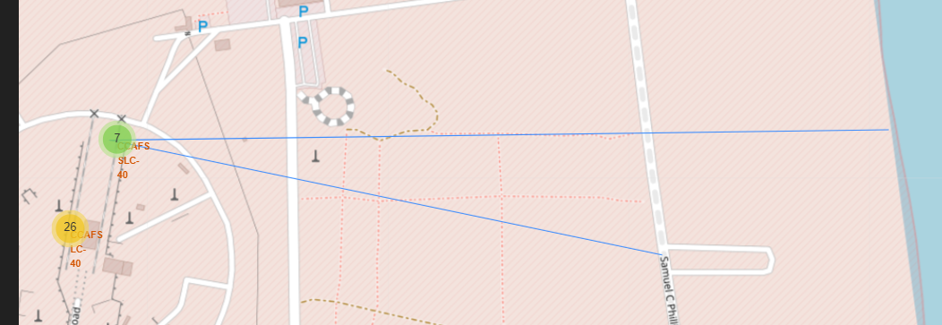
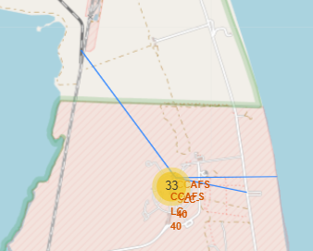
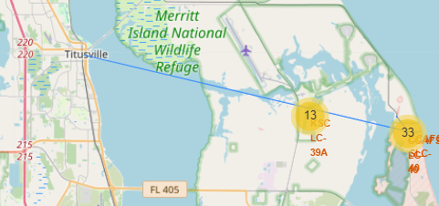
Launch Sites to Markers distance

Slide 38

Section 4

Slide 39
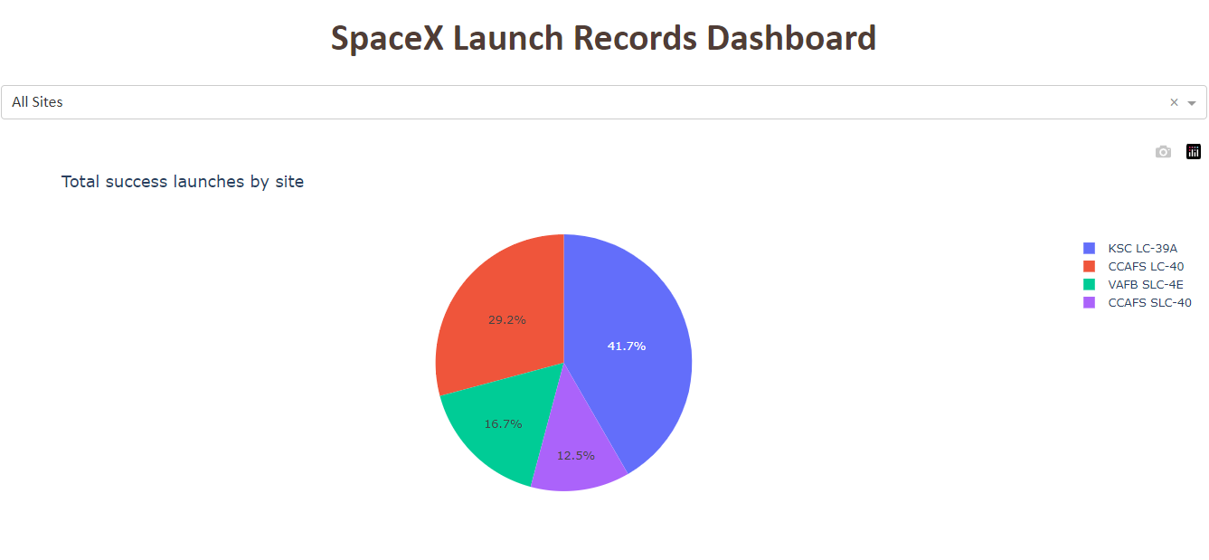
Total success launches by sites

Slide 40
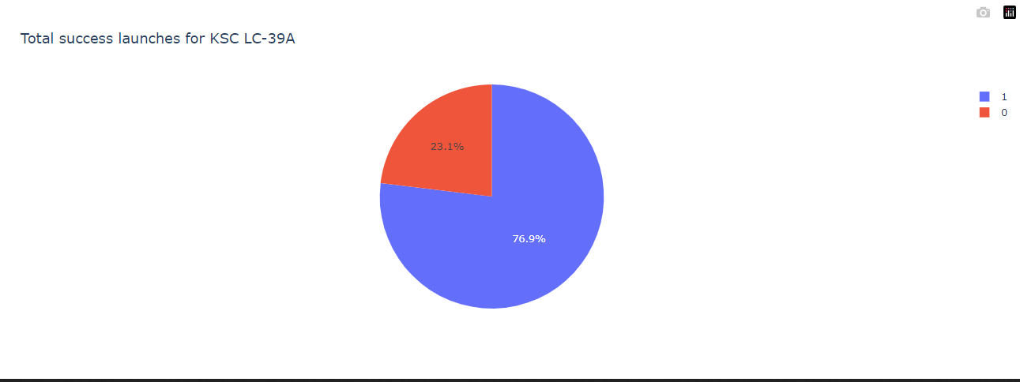
Success ratio for KSC LC-39A

Slide 41
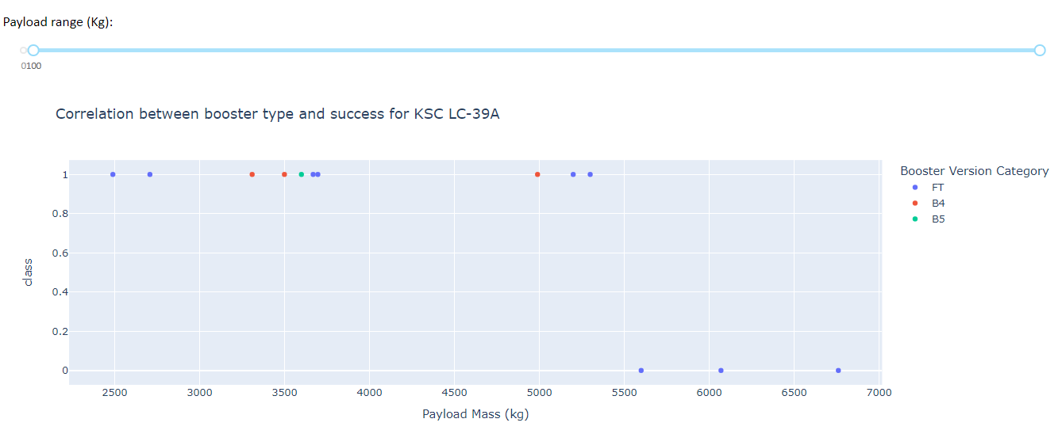
Payload vs Launch outcome scatter plot

Slide 42

Section 5

Slide 43
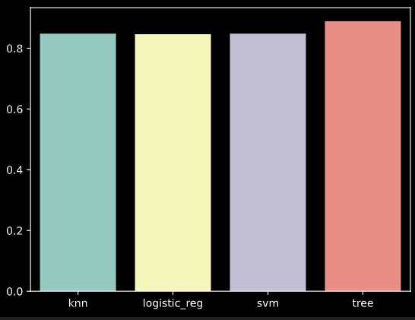
Classification Accuracy
From the chart, you can see that out of all the classification algorithms, the decision tree algorithm had the best accuracy score.

Slide 44
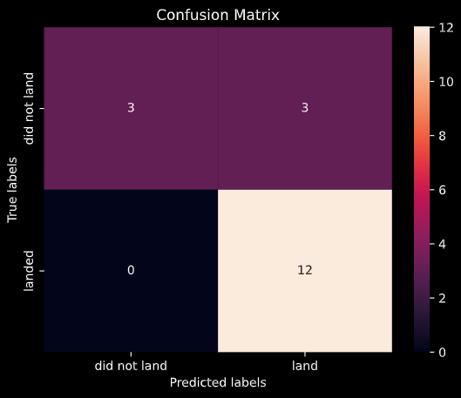
Confusion Matrix
The confusion matrix was plotted for the best performing model (Decision tree classifier) showing the True Positives, False positives, True Negatives and False Negatives.
True Positives: 12
True Negatives: 3
False Positives: 3
False Negatives: 0

Slide 45
Conclusions
Point 1
Point 2
Point 3
Point 4
…

Slide 46


